Slide 1
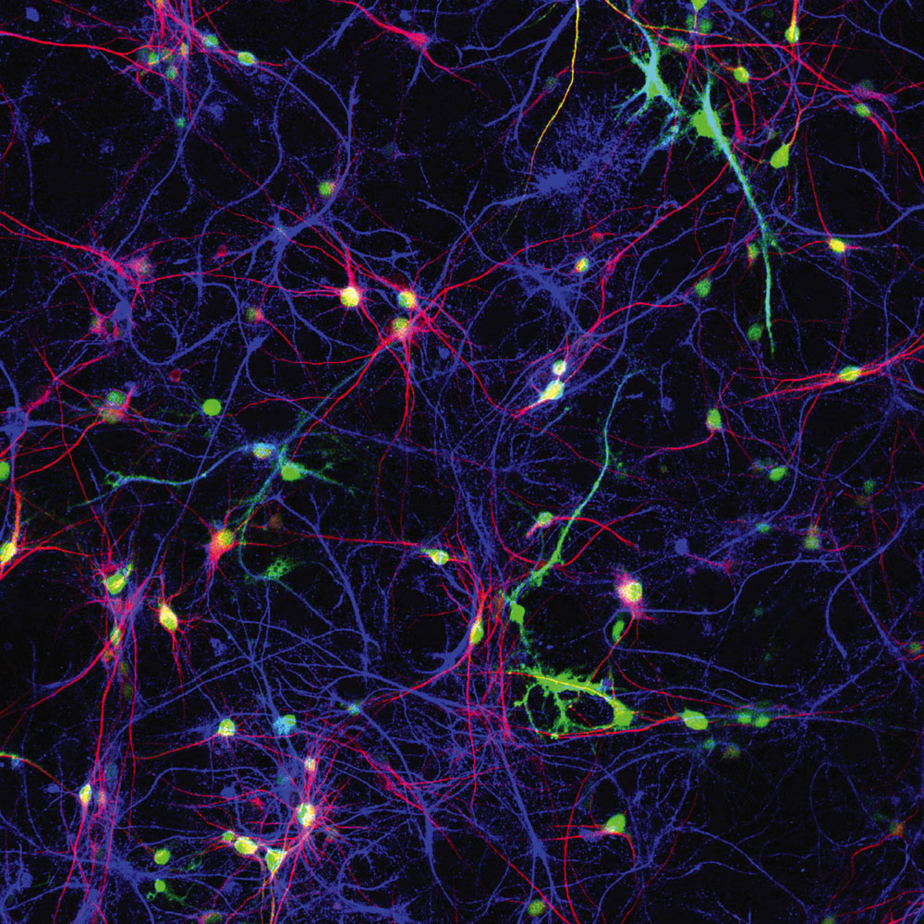
Chapter 3
Biological Aspects of Psychology

Slide 2
Biological Psychology
All behavior and mental processes are based on biology.
  But, are also influenced by the environment
Two primary systems direct the activities of the body.
  The nervous system
  The endocrine system

Slide 3



Gene-Environment Interactions
Range of reaction: Our genes set definite limit on our potential, and the environment determines how much of that potential is achieved.
Genetic environment correlation: Our genes influence our environment, and our environment influences the express of our genes.

Slide 4
Cells of the Nervous System
What are neurons,
and what do they do?

Slide 5
Cells of the Nervous System
Neurons
  Have the ability to send and receive signals
  Organized in neural networks
Glial cells
  Help neurons communicate
  Malfunctions may lead to problems

Slide 6
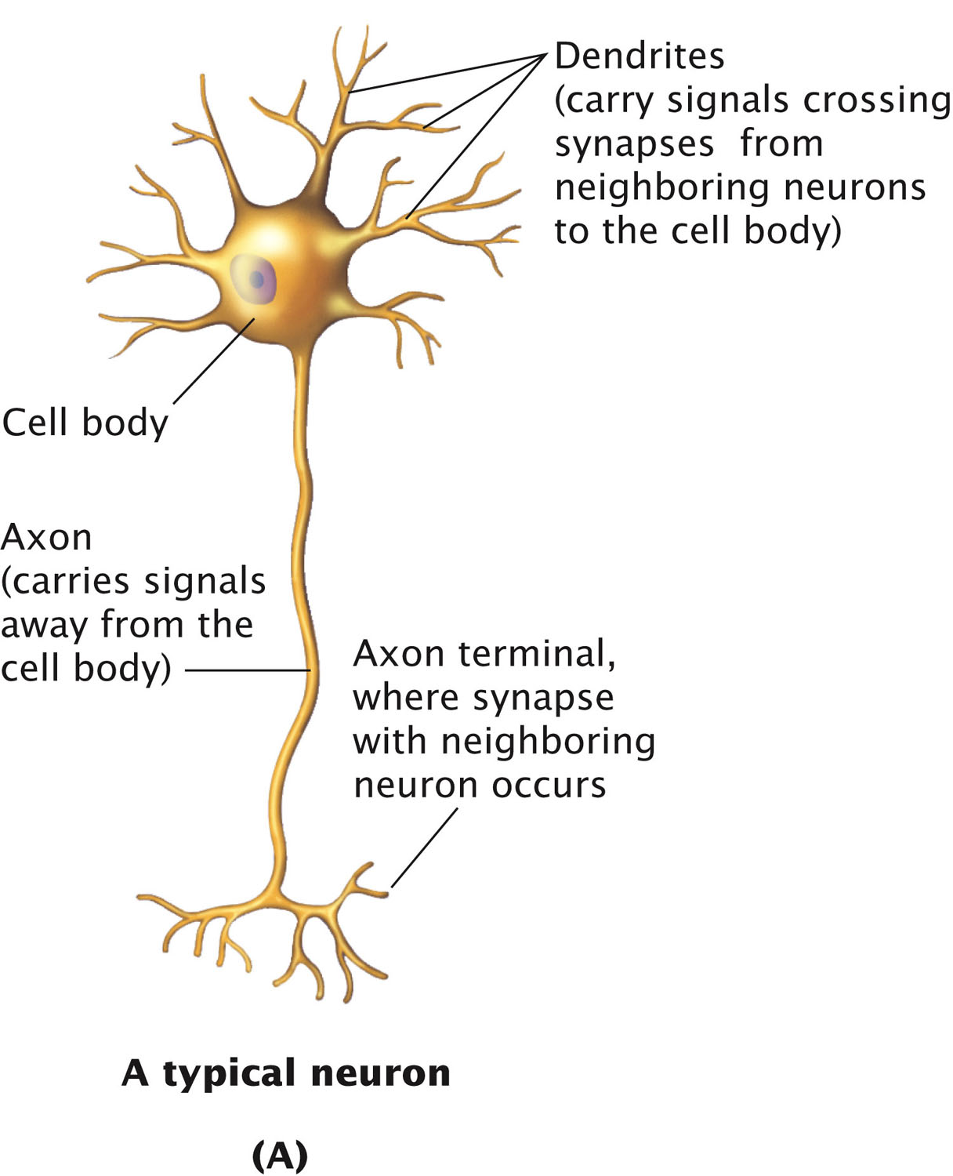
A Typical Neuron
Cell body
  Similar to other cells
Axon
  Sends signals to other neurons
Dendrites
  Receive signals from other neurons

Slide 7
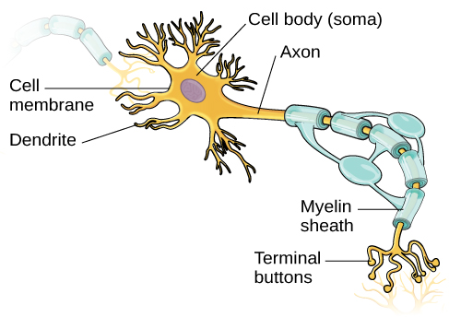
Figure 3.8
Myelin sheath: a fatty substance which coats the axon and increases the speed at which the signal travels.
Multiple sclerosis: loss of myelin sheath on axons, leading to symptoms such as dizziness, fatigue, loss of motor control, etc.

Slide 8
Neural Transmission
How do neurons communicate?

Slide 9
Neuronal Communication
Resting potential:
Sodium (Na⁺) is more concentrated outside the cell and tend to move into the cell.
Potassium (K ⁺) is more concentrated inside the cell and tend to move out of the cell.
The inside is slightly more negative than the outside.

Slide 10
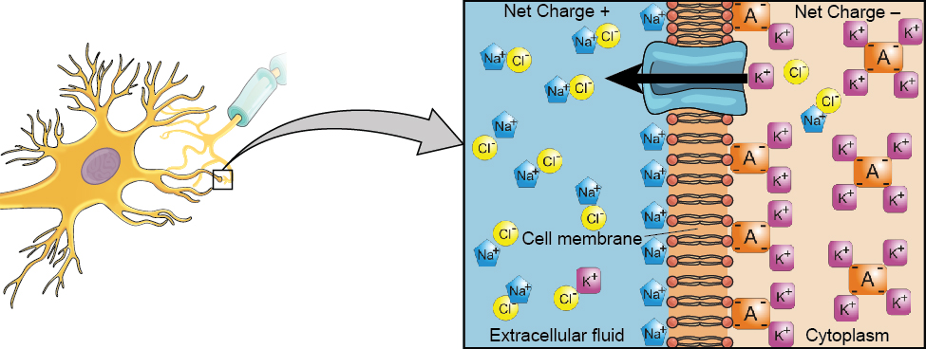
At resting potential, Na⁺ (blue pentagons) is more highly concentrated outside the cell in the extracellular fluid (shown in blue), whereas K⁺ (purple squares) is more highly concentrated near the membrane in the cytoplasm or intracellular fluid. Other molecules, such as chloride ions (yellow circles) and negatively charged proteins (brown squares), help contribute to a positive net charge in the extracellular fluid and a negative net charge in the intracellular fluid.

Slide 11
Neuronal Communication
Action potential:
Dendrites receive signals
Sodium gates on the membrane open, allowing Na⁺ ions to move into the cell.
Internal charge becomes more positive. If reaches a certain level (threshold of excitation), the neuron fires.
More gates open, causing a massive influx of Na⁺ ions to rush in and a huge positive spike in the membrane potential.
At the peak of the spike, the sodium gates close and the potassium gates open, causing K ⁺ ions to leave.
Repolarization → hyperpolarization → resting potential

Slide 12
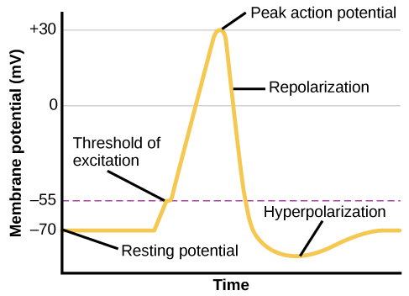
The action potential moves all the way down the axon to the axon terminals.
Action potential is an all-or-none phenomenon, meaning that the neuron either fire or doesn’t fire.

Slide 13
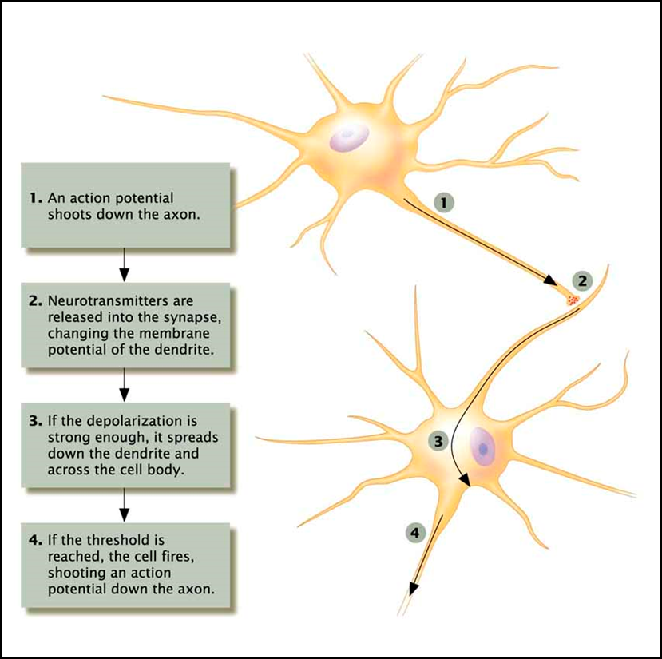
Communication between Neurons

Slide 14
Synapses
Areas for the transfer of signals between neurons
Neurotransmitters cross to receptors on other cells

Slide 15
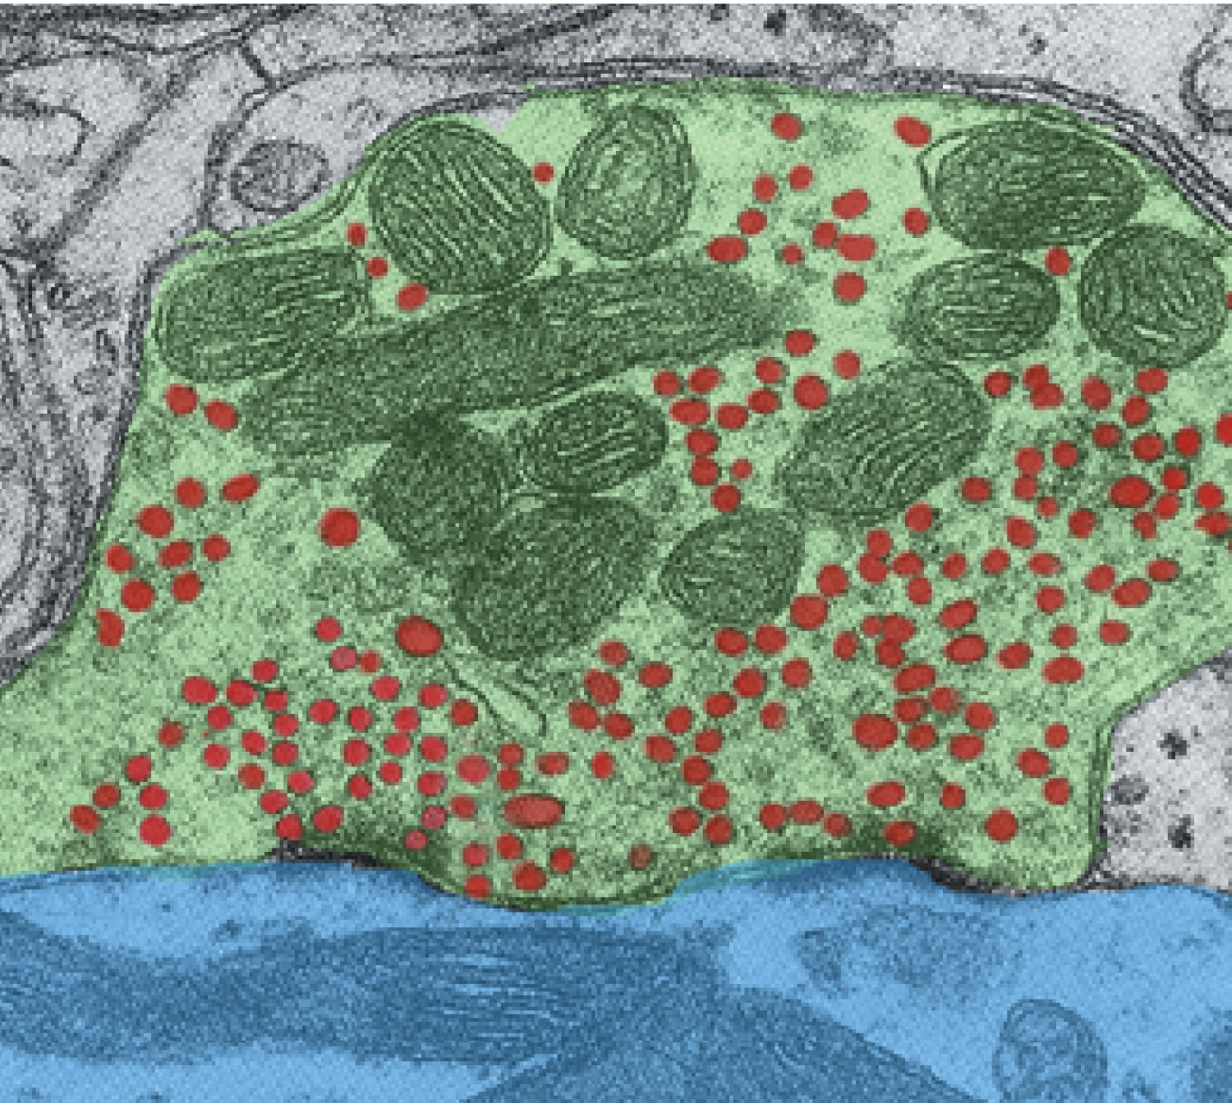
A Synapse
This photograph shows part of a synaptic gap between two neurons, magnified 50,000 times. The ending of the presynaptic cell’s axon is shaded green, the green ovals are mitochondria, and the red spots are the vesicles.
The synapse itself is the narrow gap between the first cell’s green-shaded axon and the blue-shaded dendrite of the cell below.

Slide 16
Neurotransmitters
Stored in vesicles
Chemicals released by one cell that bind to the receptors on another cell
Tell the next cell to fire or not to fire its own action potential

Slide 17
Receptors
Proteins on the cell membrane that receive chemical signals
Recognize specific neurotransmitters
  Each receptor recognizes only ONE type of neurotransmitter
  Each neurotransmitter type can bind to several different receptor types

Slide 18
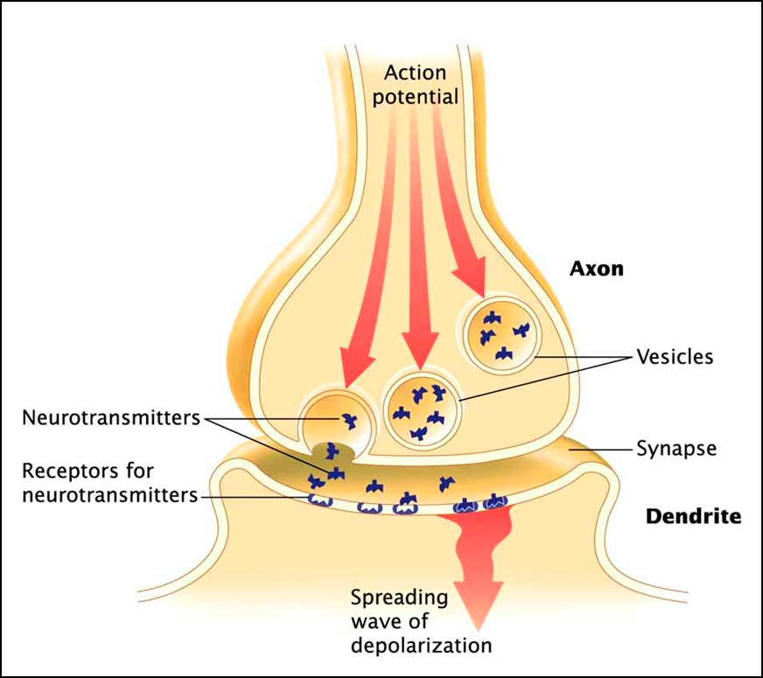
Communication between Neurons

Slide 19
Neurotransmitter
Function:
- A chemical released by one cell that binds to the receptors on another cell.
Type of Signal Carried:
- A chemical message telling the next cell to fire or not to fire its own action potential.

Slide 20
Small Molecule Neurotransmitters
Neurotransmitter Normal Function Disorder Associated with Malfunction
Acetylcholine Memory, movement Alzheimer’s disease
Norepinephrine Mood, sleep, learning Depression
Serotonin Mood, appetite, impulsivity Depression
Dopamine Movement, reward Parkinson’s disease, schizophrenia
GABA Sleep, movement Anxiety, Huntington’s disease, epilepsy
Glutamate Memory Damage after cardiovascular accident

Slide 21
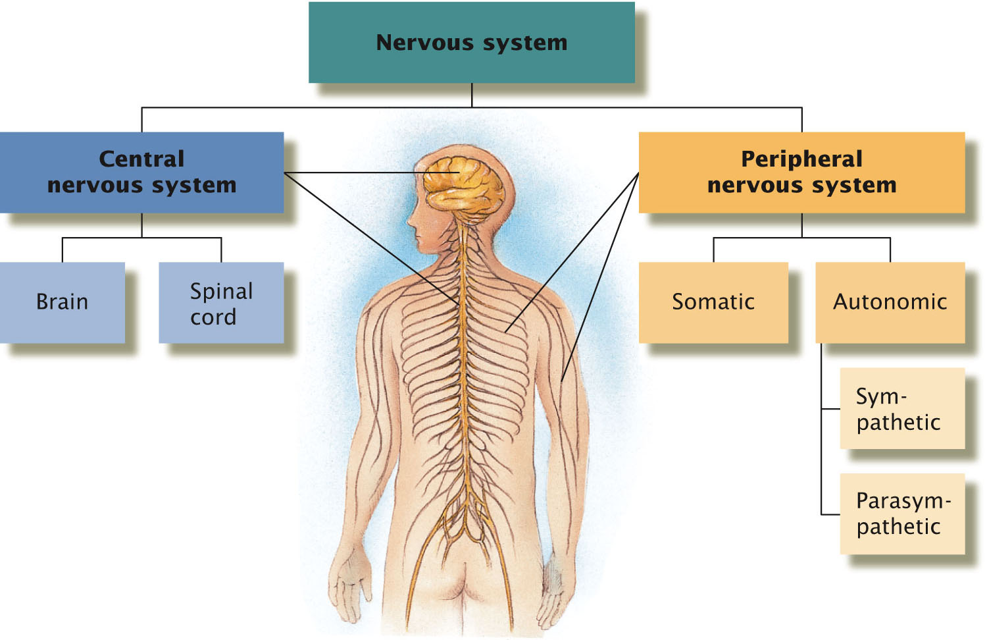
The Nervous System
The nervous system has two major divisions
  Central Nervous System (CNS)
  Peripheral Nervous System (PNS)
Back to TOC

Slide 22
The Peripheral Nervous System: Keeping in Touch with the World
How do sights and sounds
reach my brain?

Slide 23
Somatic Nervous System
Sensory neurons (afferent neurons)
  Send sensory information to CNS
Motor neurons (efferent neurons)
  Send messages from CNS to muscles
Back to TOC

Slide 24
Autonomic Nervous System
Controls activities normally outside of conscious control.
Two Subsystems
  Sympathetic nervous system
    “Spends” energy
  Parasympathetic nervous system
    “Preserves” energy

